Slide 1
Online Examination system
Guided By- Prof. Revati Raspayle
Presented By: Revati Chaudhari
Atharv Patil
Pranav Chavan
Nikhil Mahajan

Slide 2
Software requirement
Operating System
Windows 8 and Others
Front end
HTML and Bootstrap
Back End
Python with Django and SQLlite
Browser
Internet explorer, Google Chrome and EDGE.

Slide 3
Hardware requirements
Processor
Intel i3 4thGen and Others
Ram
Minimum 2GB

Slide 4
Exam Module
Examination process
Login to online examination system
Select the test
Attend test
Submit
The form of question in test page
Multiple choice question

Slide 5
Student Aspect
Sign Up
Logging into the system
Selecting the test
Appearing for the examination
Printing the result at the end of the examination

Slide 6
Administrator aspect
Editing/Deleting/Creating the database.
Logging into the system.
Accepting registration .
Creating the test.
Posting questions in the above test.
Posting multiple options to respective question.
Marking correct answer within the given option.

Slide 7
HTML and bootstrap
Hypertext Markup Language, a standardized system for tagging text files to achieve font, colour, graphic, and hyperlink effects on World Wide Web pages.
Bootstrap is the most popular HTML, CSS and JavaScript framework for developing a responsive and mobile friendly website.
It is a front-end framework used for easier and faster web development.

Slide 8
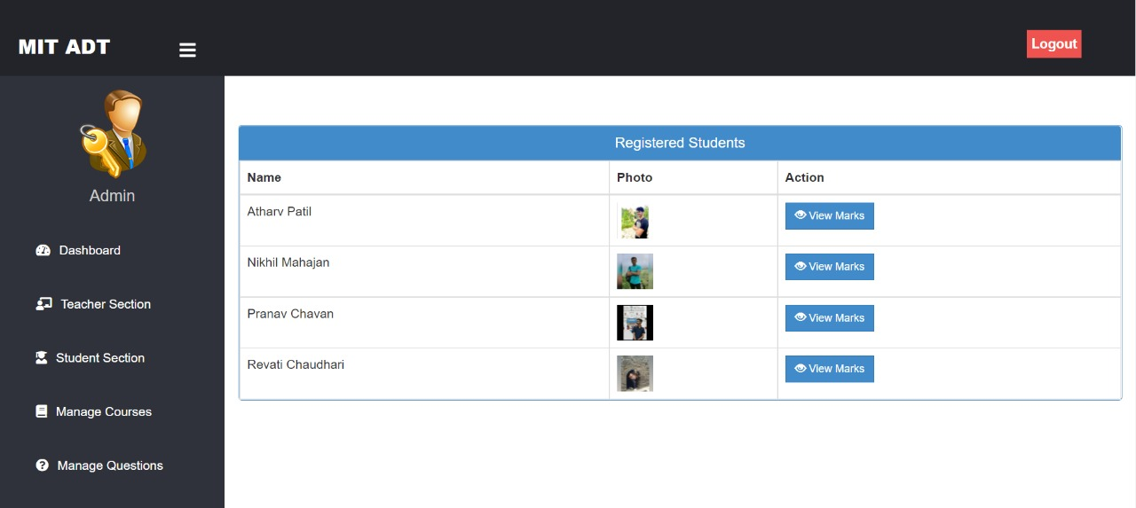
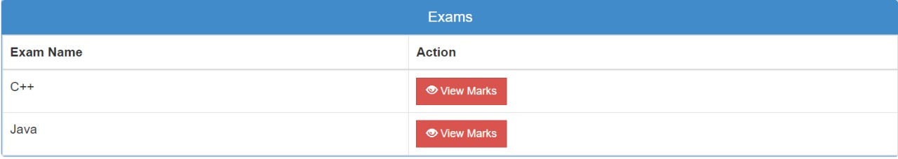
SQL
To access a database, we use SQL statements. The following SQL statement selects all records in a database table called “Students“
A database most often contains one or more tables. Each table is identified by a name like “Students" or “Exam". Below is a selection from a “Student" table:

Slide 9
DJANGO
Django is one of the free and open-source Python web frameworks. It allows users to build secure, clean and maintainable websites. It distinguishes itself among other frameworks because it is fast. It includes tons of packages, it is scalable as well as versatile.
The Django Template Engine allows us to create basic HTML templates for our data. This is a convenient way to generate HTML dynamically. We use template language for variables and basic logic that Django then uses to interpolate values inside HTML elements.

Slide 10
Thank you:)

